Slide 1
People Express
Jakub Mifek

Slide 2
First attempts
Yr 6, Q 1 – Revenue 353.8
Yr 2, Q2 – Revenue 100.26
…

Slide 3
Observations
Aircraft amount grows with demand
We need ~80 people for hiring per airplane acquired + turnover
We cannot keep low prices -> our target should aim for higher

Slide 4
Strategy
Increase demand -> marketing
Keep airplane acquisitions up with demand
Keep high quality by hiring more people and training them (think for the future)
Gradually increase prices
Increase the scope of service (keeps the demand)

Slide 5
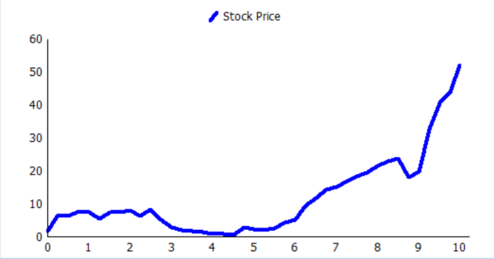
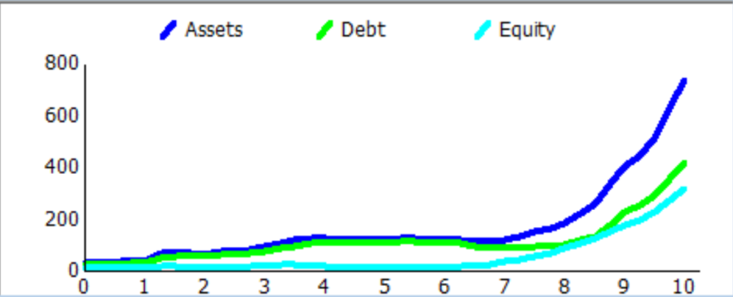
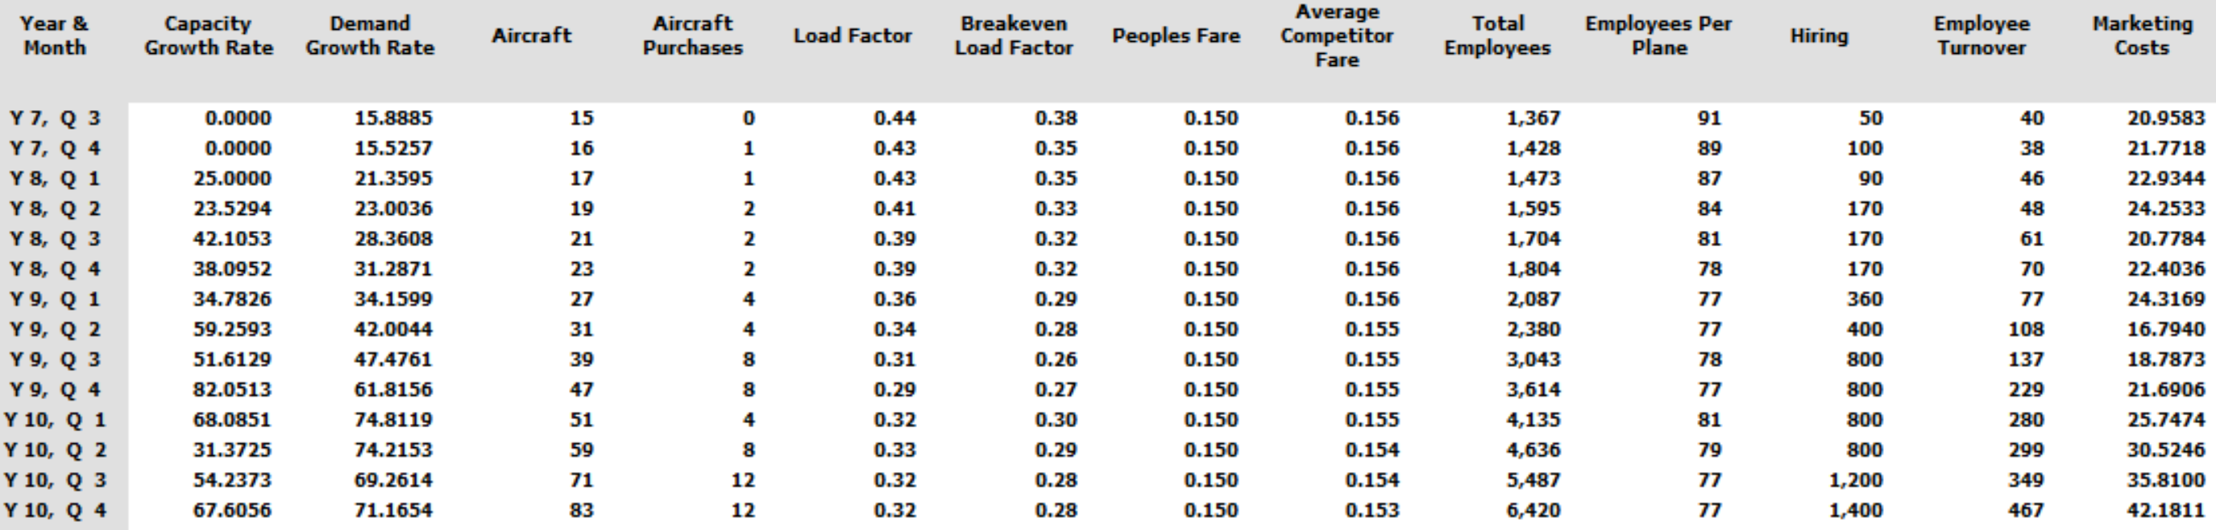
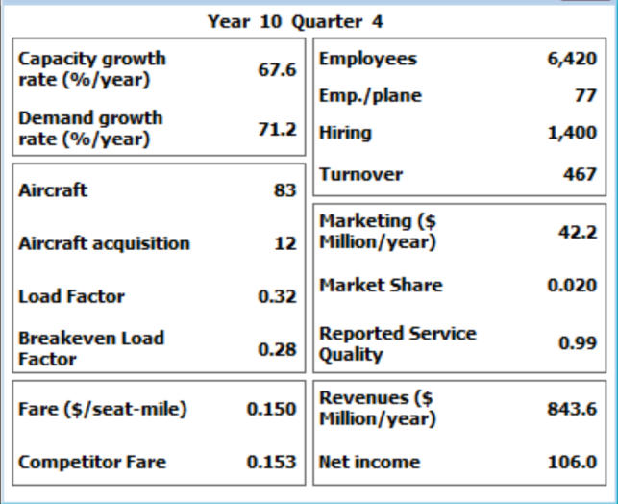
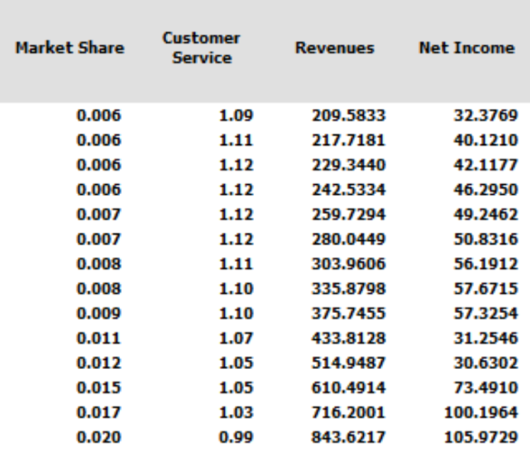
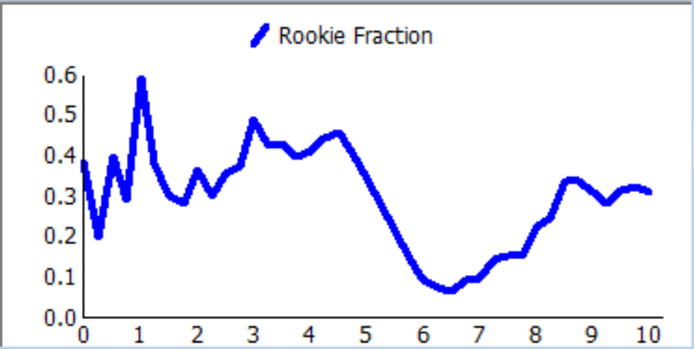
Finally…

Slide 6
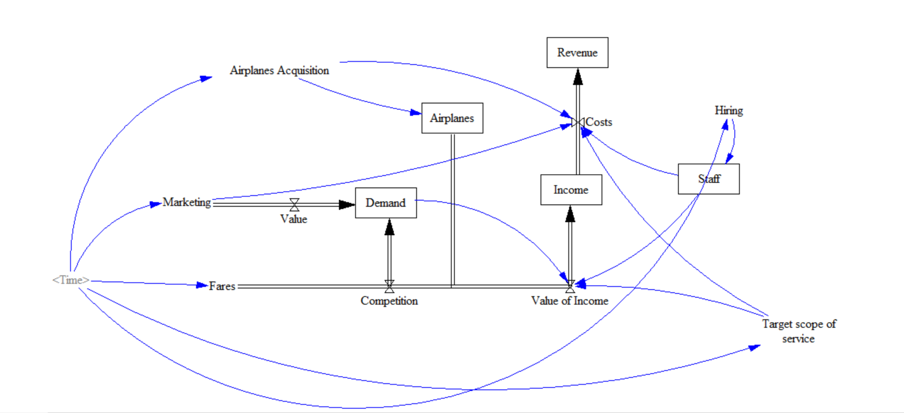
Vensim

